Slide 1
Reminder: Base graphics: plot()
Plot is the generic function for plotting R objects
points, lines, etc.
Read in the "primates.csv" data
> primates <- read.csv(file="primates.csv", header=T)
> primates
X Bodywt Brainwt
1 Potar monkey 10.0 115
2 Gorilla 207.0 406
3 Human 62.0 1320
4 Rhesus monkey 6.8 179
5 Chimp 52.2 440

Slide 2
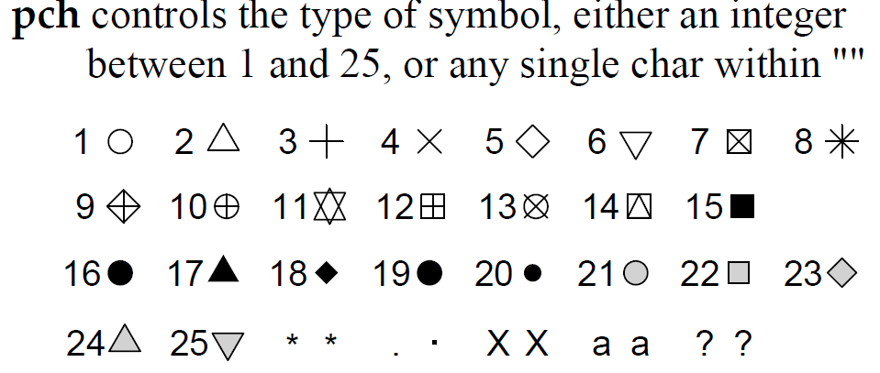
Controlling point characteristics
Default is an open circle (pch=1) of size 1 (cex=1)
pch short for plotting character
cex short for character expansion
Source: R Reference Card 2.0

Slide 3
Color naming
There are 657 named colors
colors()
point.colors <- c("red", "orange", "green", "blue",
"magenta")
plot(x = primates$Bodywt, y = primates$Brainwt,
xlim=c(0,300), ylim=c(0,1400),
cex=2, pch=19, col=point.colors)

Slide 4
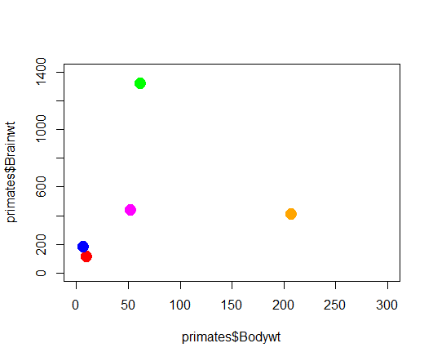

Slide 5
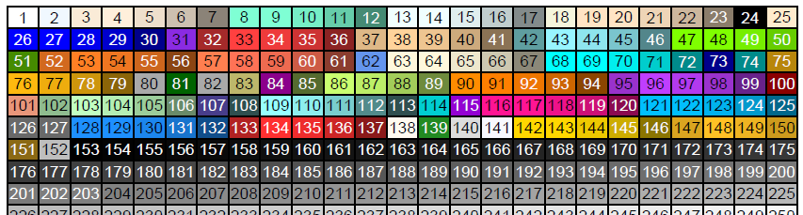
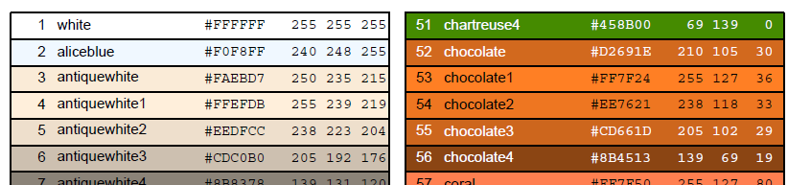
Example R color chart:
FISH 554 Beautiful Graphics in R: custom palettes, translucent colors, RGB or HSV colors, color blindness, divergent color schemes, hexadecimal, Color Brewer, etc.

Slide 6
Useful options for points
Useful code and options under ?points
Use pch=21 for filled circles, for example:
Specify circle color with col
Specify fill color with bg
plot(x = primates$Bodywt, y = primates$Brainwt,
xlim=c(0,300), ylim=c(0,1400),
cex=2, pch=21, col="black", bg="salmon")

Slide 7
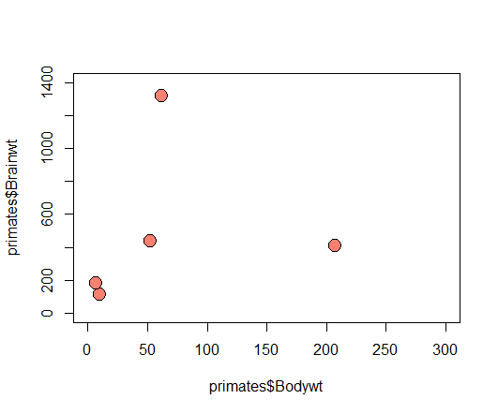

Slide 8
Full list of plot parameters: par()
If you ask for help on the plot() command using ?plot, only a handful of commands are listed
There are numerous extra commands listed under ?par that can be added to all plotting commands, not just plot()
Using par() by itself applies commands to multiple graphs (avoid!)
> par()
$xlog
[1] FALSE
...

Slide 9
Using par() for global changes avoid this whenever possible
Save default par values
old.par <- par()
Change to a new value
par(col.axis="red")
plot(x=primates$Bodywt, y=primates$Brainwt,
xlim=c(0,300), ylim=c(0,1400),
cex=2, pch=21, col="black", bg="salmon")
plot(1:3)
Restore defaults
par(old.par)
plot(1:3)

Slide 10
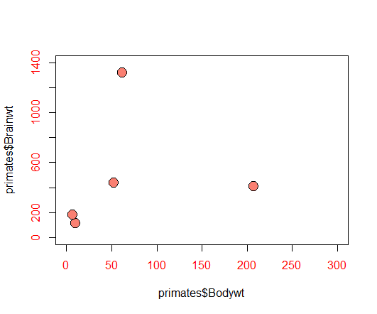

Slide 11

To return to default plotting
Selecting the Clear All command in the plotting window resets all figures and sets par() to the default values. Use this option when you have gone too far and can’t get back to a nice simple plotting screen.

Slide 12
Vector options for plotting
Many plotting options can handle vectors, each element applies to one point
Vectors are recycled if you supply too few numbers
Different point characters: pch=1:5
Different point letters: pch=c("a","t","c","g")
Different colors: col=1:5
Different sizes: cex=1:5

Slide 13
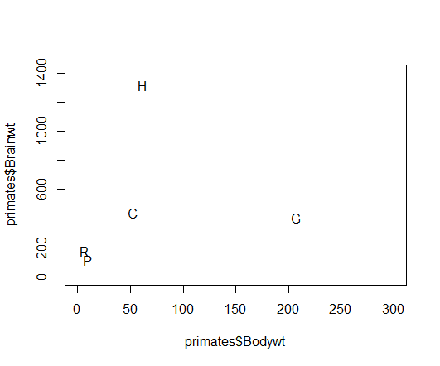
First letter of each primate’s name

Slide 14
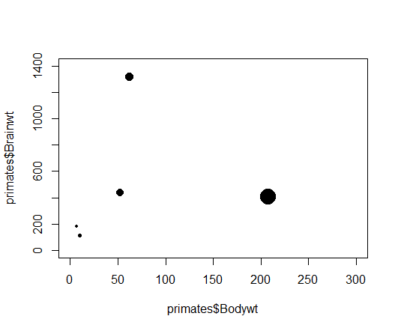
Circle size proportional to body weight

Slide 15
Adding legends
Legends do not use anything in the plot
Look up help on the legend function (?legend), note that most options in par() can be used too
legend(x="topright",
legend=primates[,1],
pt.bg=1:5,
pch=21:25,
bty="n")
also "bottomleft" etc., and can use x=100, y=100
vector of text strings
background color of points
vector of symbol type
no box type

Slide 16
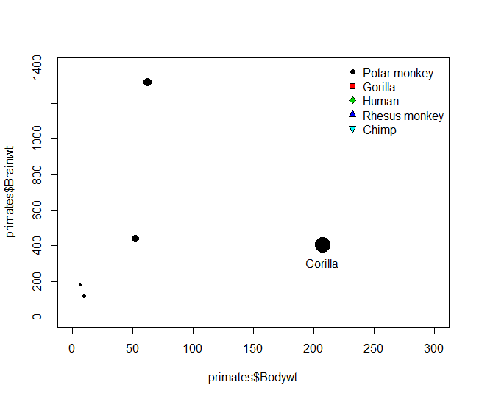
If you want the legend to correspond to the plot, you need to specify identical symbols, sizes, and colors for the plot and the legend

Slide 17
Axis properties
Tick mark labelling using yaxp and xaxp
c(min, max, number of spaces between intervals)
plot(x = primates$Bodywt, y = primates$Brainwt,
...
yaxp = c(0, 1500, 3))

Slide 18
More advanced axis properties
For more control over axes, use the axis() function
First create the plot but suppress the x or y axis using xaxt="n" and yaxt="n"
Then add axes to whichever side they are needed
plot(x = primates$Bodywt,
y = primates$Brainwt,
...
yaxt = "n")
axis(side = 2, at = seq(0,1500,300),
labels = c(0,300,600,900,1200,">1500"))

Slide 19
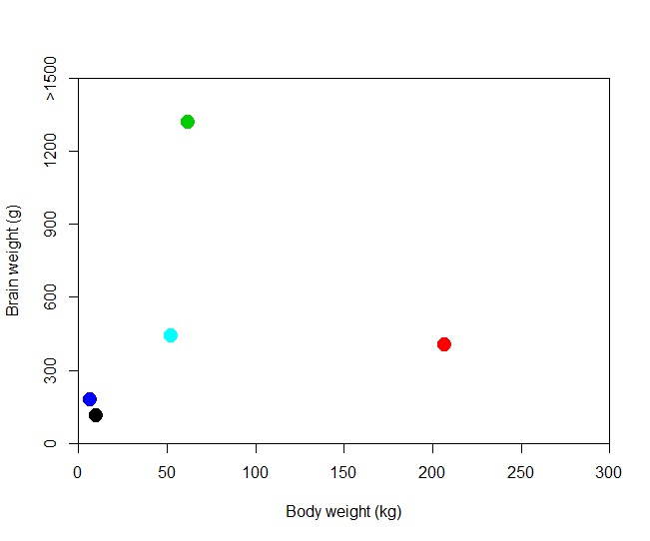

Slide 20
Adding text using locator()
Interactive function: click on the plot and it returns the x and y coordinates
> locator(1)
$x
[1] 207.6493
$y
[1] 305.7384
Add text at those coordinates
text(x=207, y=306, label="Gorilla")
Omit the 1 for multiple clicks, press <esc> to exit

Slide 21
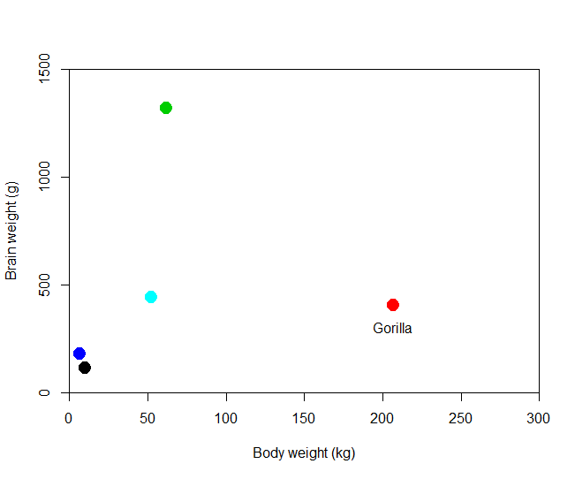

Slide 22
Labeling points using text()
Look up the help on ?text
Can use vectors for x, y, and the text strings
After creating the plot, call text()
pos=1 below
pos=2 to the left
pos=3 above
pos=4 to the right
text(x = primates$Bodywt, y = primates$Brainwt,
labels = primates[,1], pos=4)

Slide 23
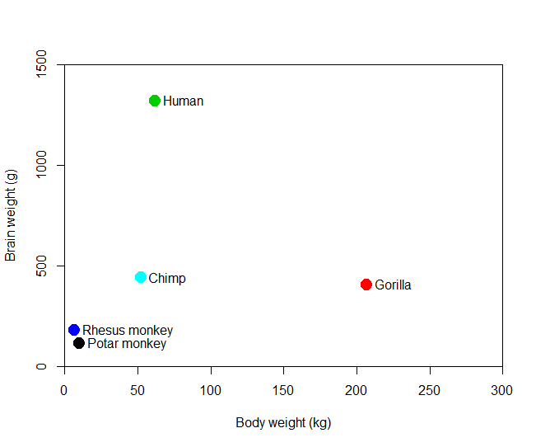

Slide 24
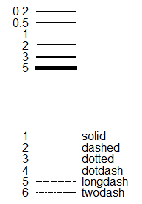
Points and lines
lwd values
?lines gives values for lty, the line types
For line widths use lwd
lty values

Slide 25
More plot types
In the plot() command, type specifies the type of plot to be drawn
"p" points
"l" lines
"b" both lines and points
"c" lines part alone of “b”
"o" overplotted
"h" histogram-like (or high-density) vertical lines
"s" stair steps
"n" for no plotting

Slide 26
Adding points or lines
You can add a series of points or lines to the current plot using points() and lines()
lines(x=seq(50,200,50), y=c(200,450,500,300),
type="b", lwd=3, lty=2)
points(x=seq(100,250,50), y=seq(100,250,50),
cex=3, pch=17)

Slide 27
